Slide 2
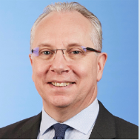
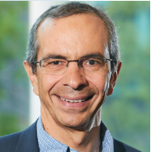
GHS Paris 2023 Co-Chairs
Prof. Jean-Michel Pawlotsky &
Prof Fabian Zoulim

Slide 3
Presentation Title Goes Here
Co-Chairs
Prof. Jean-Michel Pawlotsky & Prof Fabian Zoulim

Slide 4
Presentation Title Goes Here
Presenter Name Here

Slide 5
Title Here
Text goes here

Slide 6
Title Here
Text goes here

Slide 7
Title Here
Text goes here

Slide 8
Title Here
Text goes here

